Slide 1
Chongqing University of Technology
ATAI
Advanced Technique of Artificial Intelligence
Chongqing University of Technology
Enhancing Aspect-level Sentiment Analysis with Word Dependencies
(EACL-2021)
Code：https://github.com/cuhksz-nlp/ASA-WD
Reported by Ling Zhu

Slide 2
Chongqing University of Technology
ATAI
Advanced Technique of Artificial Intelligence
Chongqing University of Technology
1. Motivation
2. Approach
3. Experiments
4. Conclusion
Notes:
https://www.bilibili.com/video/BV13o4y1m7c3

Slide 3
Motivation
Most of them mainly focus on using the dependencies among words and omit to leverage other information such as relation types, which could provide useful cues to predict the sentiment. Also, they model all dependency information instances equally without weighting them according to their contribution to the task, where noisy information from the auto-generated dependency tree may hurt model performance.
Notes:
Chinese DataSet field:content, comments,label, content_emotions, comments100_emotions_mean_pooling, comments100_emotions_max_pooling

Slide 4
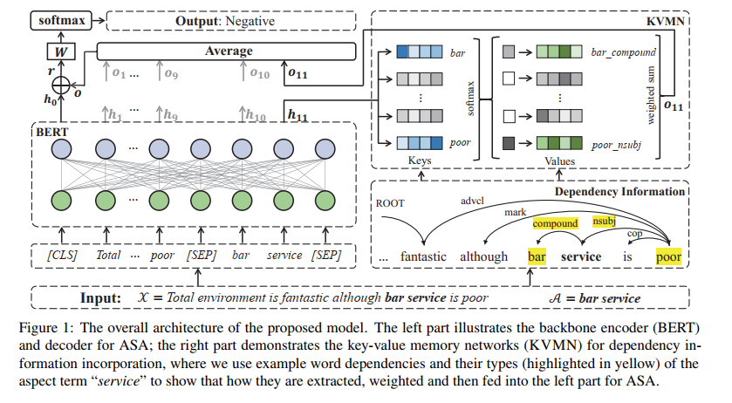
Approach
Key-Value Memory Networks for directly Reading Documents-ACL2016

Slide 5
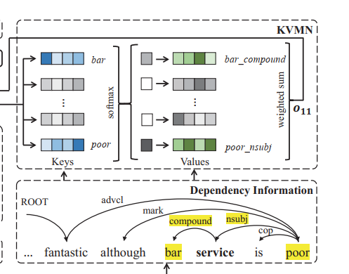
Approach
KVMN for Word Dependencies
$h_{i}$ for $w_{i}$from the encoder,(i.e BERT)
Notes:
First-order: For “service”,$K_{i}=\left\{bar,poor\right\},V_{i}=\{bar_compound , poor_nsubj\}$

Slide 6
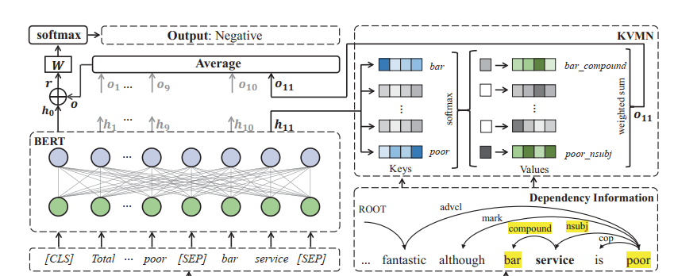
Approach
Word Dependency Integration for ASA
the value of l equals to n, m, or n + m if all $w_{i}$ come from X only, A only, or X +A, respectively
Notes:
https://github.com/NVIDIA/sentiment-discovery
https://ai.baidu.com/tech/nlp/emotion_detection
Emotion Category----工具NVIDIA,Baidu AI
Emotion Lexicon,Emotional Intensity----NRC Emotion lexicon,Affective Lexicon Ontology
Sentiment Score—Vader,HowNet
Other Auxiliary Features---Wikipedia,HowNet,and others

Slide 7
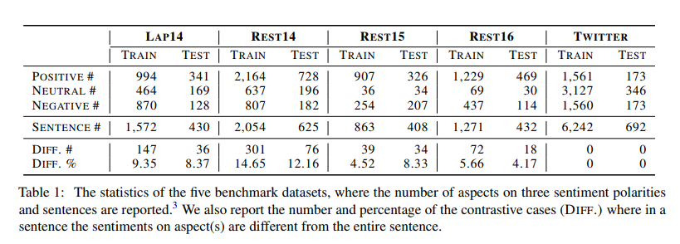
Experiments
Notes:
English dataset,

Slide 8
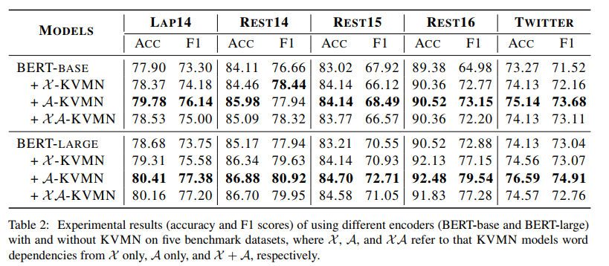
Experiments

Slide 9
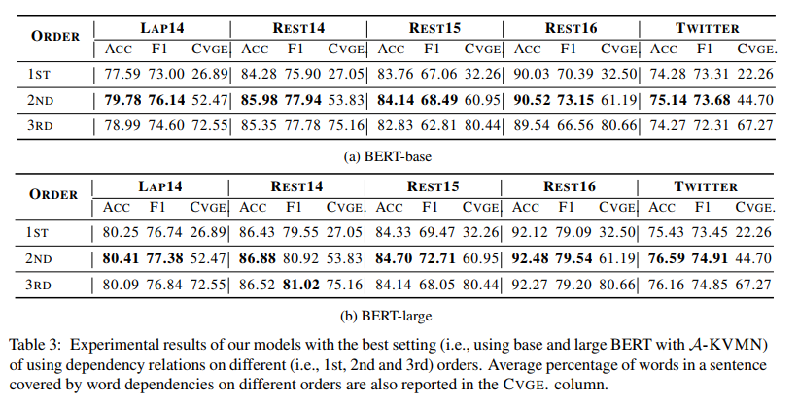
Experiments

Slide 10
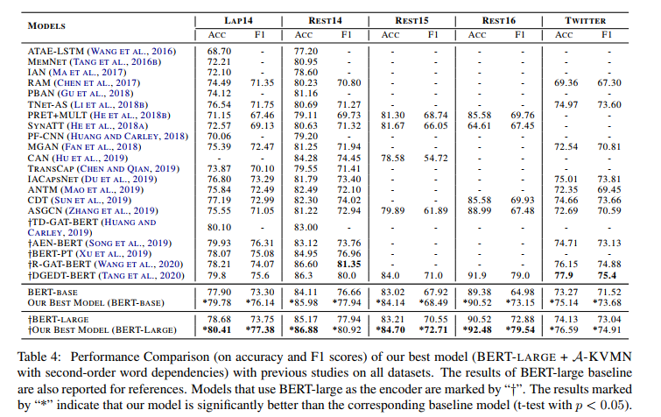
Experiments

Slide 11
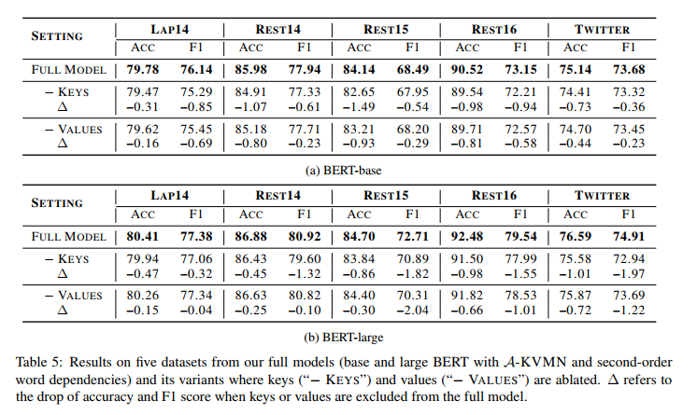
Experiments

Slide 12
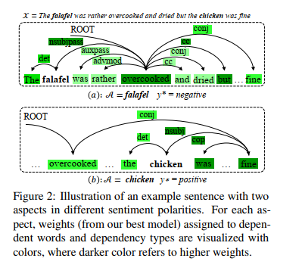
Experiments

Slide 13
Thanks

